Slide 1
Making maps and analyzing spatial data An introduction to using R for archaeologists
Liying Wang
Workshop, June 2020

Slide 2
Archaeologists often deal with spatial data, and R is a very useful tool for us because
It can manipulate, visualize, and analyze spatial data
It makes our work transparent and reproducible
It can handle large spatial dataset efficiently

Slide 3
What we are going to do
Maps making
spatial data manipulation and visualization
Density analysis and hypothesis testing to test our theory about distributions.

Slide 4
In this workshop, I will
introduce the packages & concept of spatial data
explain the purpose for each step & display the output by slides
Then switch to R Markdown file & explain the functions
demonstrate running each code chunk

Slide 5
After my demonstration, you will
practice running code (## Exercise) in R Markdown file
let me know if you encounter any issues

Slide 6


R Packages we will use for today
rnaturalearth, rnaturalearthdata: spatial data download
sf, sp, raster: spatial classes
tidyverse, maptools: data manipulation, and spatial objects manipulation
ggplot2, ggmap, ggspatial: visualizations
spatstat: spatial data analysis
Shadowtext: text for ggplot2

Slide 7
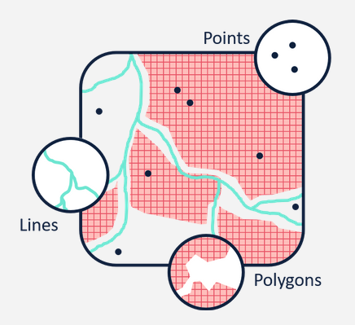
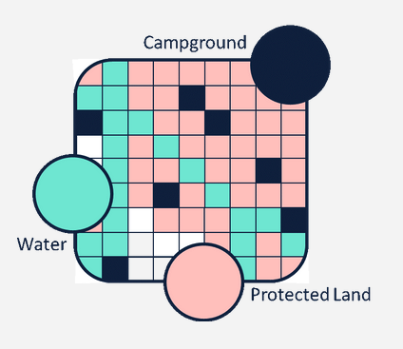
There are two types of spatial data
Vector stores geospatial data as points, lines, and polygons
Raster stores geospatial data as a surface divided into a series of cells (pixels)
https://www.vebuso.com/2019/01/vector-raster-tale-two-spatial-data-types/

Slide 8

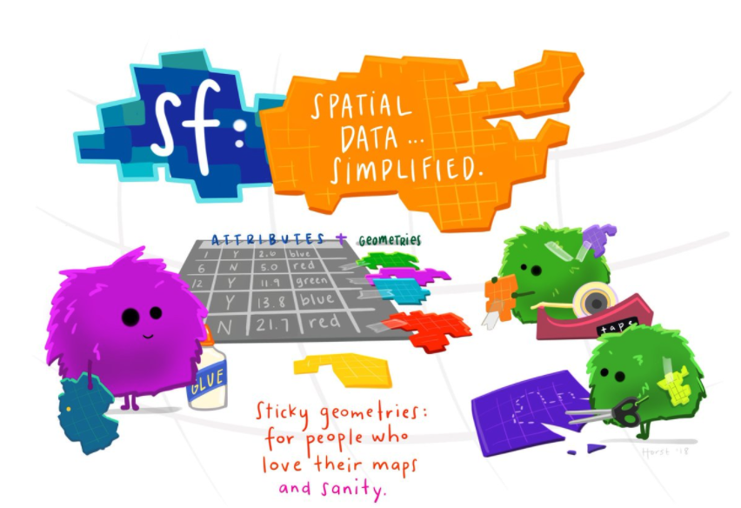
Simple features (sf) is used to describe vector data, It stores attributes and geometries in the form of a data frame
The Illustation is made by Allison Horst
Artist-in-Residence at RStudio

Slide 9
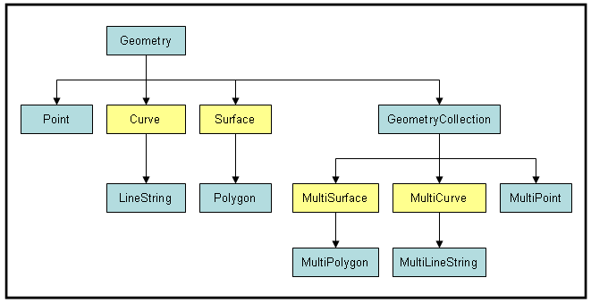
There is a hierarchical structure of geometry class for simple features
http://gsp.humboldt.edu/Websites/BlueSpray/STUsersGuide/Scripting/Script_SimpleFeatures.html

Slide 10
Set up: install packages and download data

Slide 11

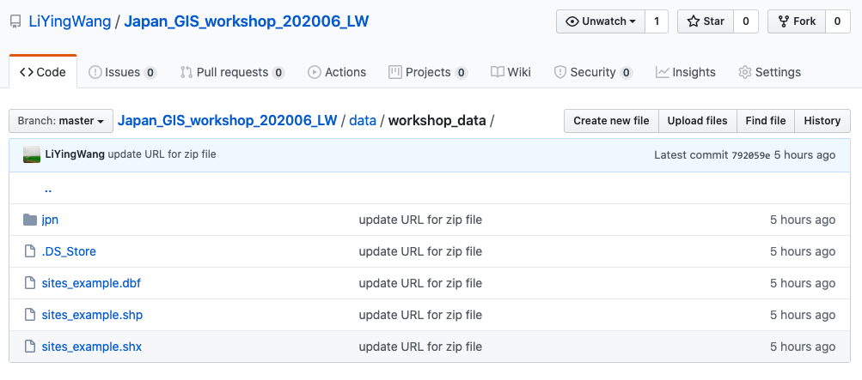
The raster data we use in this workshop is downloaded from https://www.gsi.go.jp/kankyochiri/gm_japan_e.html. The shapefile is an example created only for the purpose of demonstration.

Slide 12

Let’s work on it together
install.packages()
download.file()

Slide 13
Part 1: Making maps

Slide 14
We can make nice maps for our reports and publications
Regional maps: small-scale maps show larger area with a smaller amount of detail, eg. World map
Site maps: large-scale maps show smaller area with a greater amount of detail

Slide 15
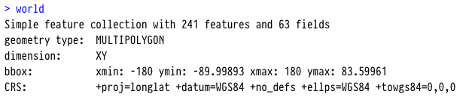
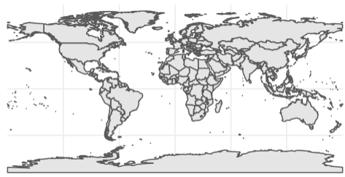
We use world map to create the regional map we want

Slide 16
Your turn ## Exercise 1

Slide 17
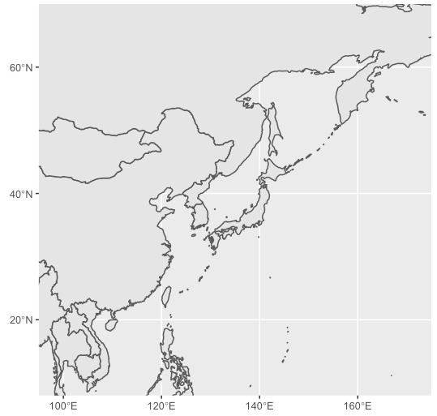
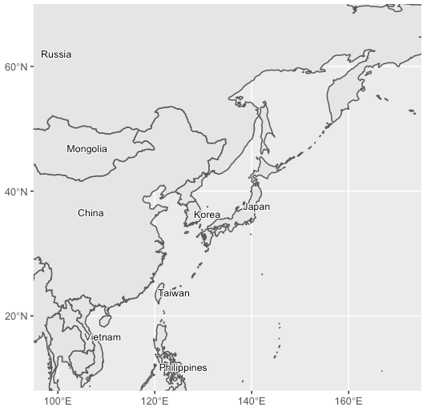
We can label country names on the map

Slide 18
Your turn ## Exercise 2

Slide 19
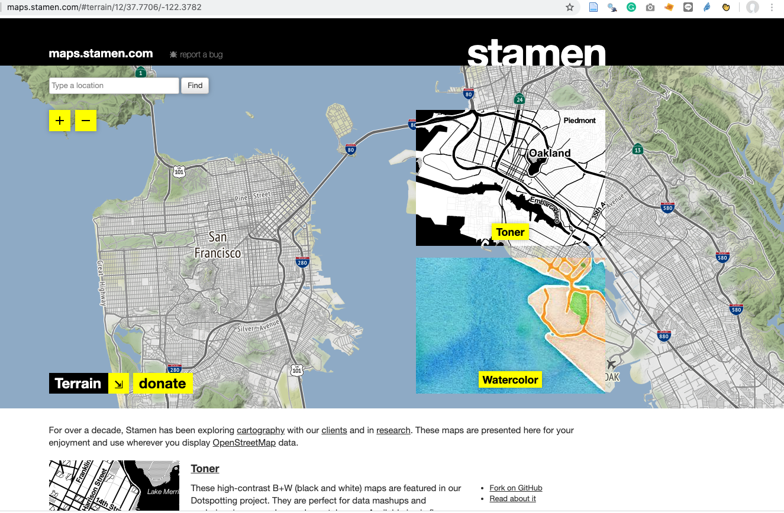
For site map
Use get_stamenmap () function to get terrain map
http://maps.stamen.com/#terrain/12/37.7706/-122.3782

Slide 20
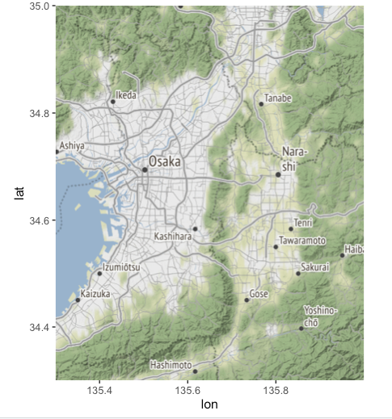
Specify the coordinates get the area we want

Slide 21
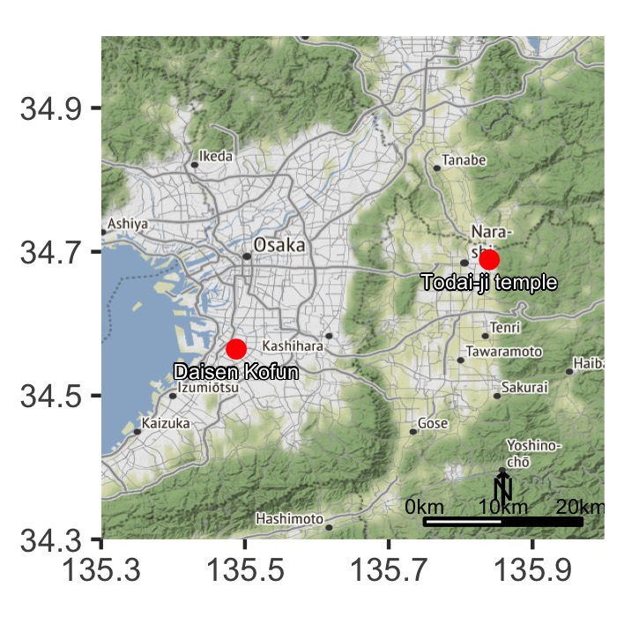
To make a site map, we will need to add the locations of site on it

Slide 22
Your turn ## Exercise 3

Slide 23
We have learned:
Read data for mapping into R
Making regional map
Making site map

Slide 24
Part 2: Spatial data manipulation and visualization

Slide 25
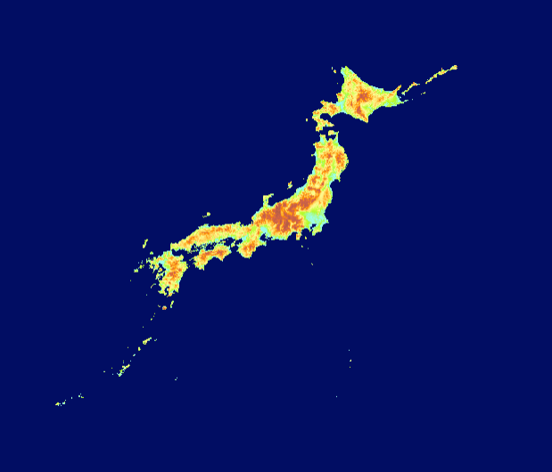
The raster data is downloaded from Global Map Japan, which is a Digital elevation model (DEM) layer

Slide 26
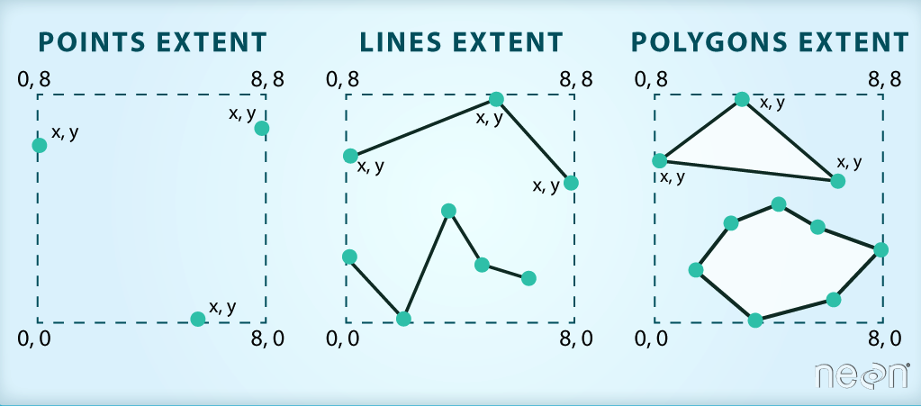
Crop a raster to match our site map
Clip a raster using a Shapefile
https://datacarpentry.org/r-raster-vector-geospatial/11-vector-raster-integration/index.html

Slide 27
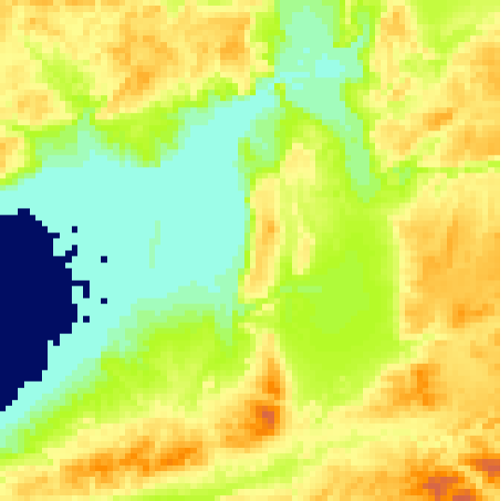
Let’s use a square polygon to crop the raster!

Slide 28
Your turn ## Exercise 4

Slide 29
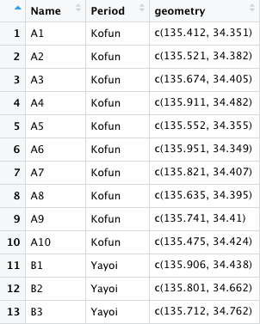
We will read and plot point vector data stored in shapefile format in R

Slide 30
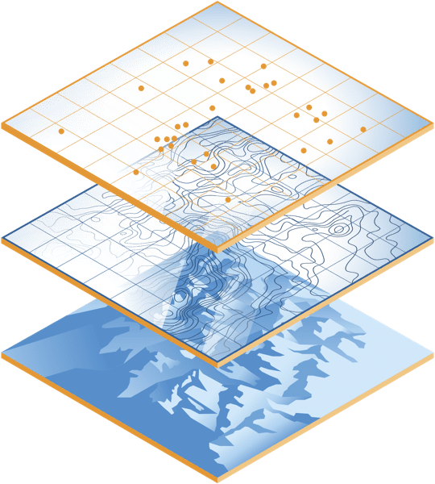
Different types of spatial data can be integrated and represented as a map layer
https://developers.arcgis.com/features/maps-and-data/

Slide 31
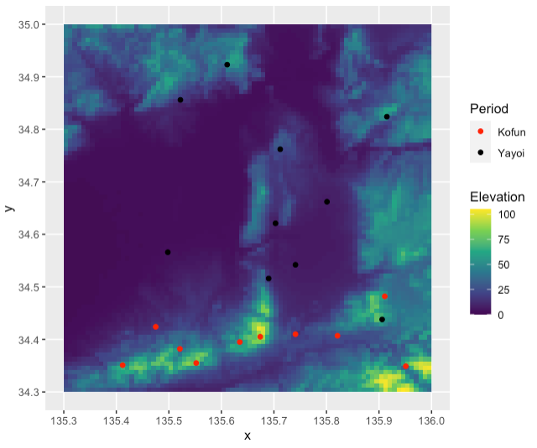
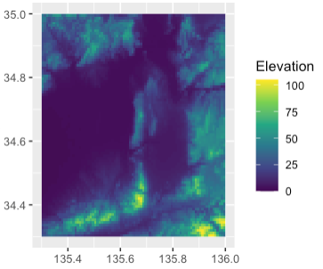
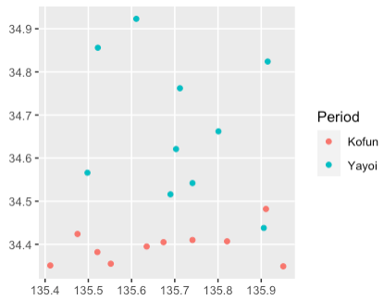
Let’s add the sites onto the cropped raster data
=
+

Slide 32
Your turn ## Exercise 5

Slide 33
We want to know the elevation for the sites by extracting elevation values from raster data

Slide 34
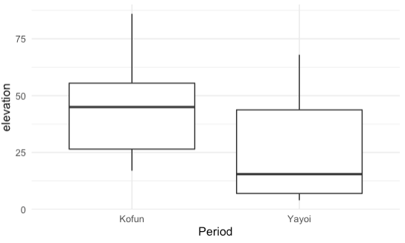
After extracting the elevation, we compare sites from different phases

Slide 35
Your turn ## Exercise 6

Slide 36
We have learned:
Read raster data, and crop the area we want
Add sites onto the raster map using ggplot
Extract elevation from raster data for site locations

Slide 37
Part 3: Density analysis and hypothesis testing

Slide 38
Visualization of density
We use spatstat package for analyzing Spatial Point Patterns
Density function computes an isotropic kernel intensity estimate of the point pattern

Slide 39
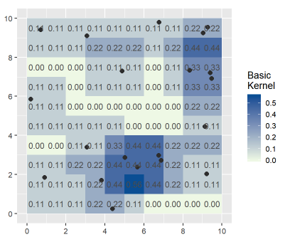
If there is one point in a 3x3 unit (pixel) region, then the density value is 1/9 = 0.11

Slide 40
Your turn ## Exercise 7

Slide 41
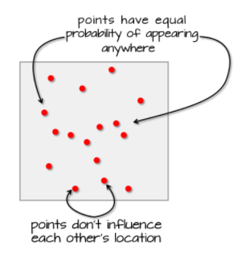
Spatial data analysis
how to determine the distribution of sites or artifacts is random or not?
presence, absence, and null (missing)
complete spatial randomnesss (CSR)
https://mgimond.github.io/Spatial/hypothesis-testing.html

Slide 42
We can test for CSR by comparing the observed value with a distribution of points under the process which was completely random
The Average Nearest Neighbor (ANN) method measures the distance between each feature centroid and its nearest neighbor's centroid location.

Slide 43
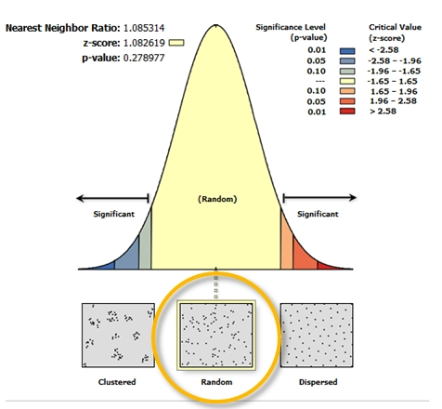
We will make a histogram of simulated ANN values that follow the null hypothesis that a distribution is consistent with a completely random process (CSR), and see where our observed ANN value falls in

Slide 44
Your turn ## Exercise 8

Slide 45
We have learned:
Density visualization
Hypothesis testing for distribution

Slide 46
Contact me if you have any questions!
Email: liying15@uw.edu
Twitter: @LiyingWang10
Facebook: r97125008@ntu.edu.tw

Slide 47


